Slide 1

CIS 540 Principles of Embedded Computation Spring 2015 http://www.seas.upenn.edu/~cis540/
2a
Instructor: Rajeev Alur alur@cis.upenn.edu

Slide 2
Model-Based Design
Block Diagrams
Widely used in industrial design
Tools: Simulink, Modelica, LabView, RationalRose…
Key question: what is the execution semantics?
What is a base component?
How do we compose components to form complex components?
CIS 540 Spring 2015; Lecture Jan 21

Slide 3
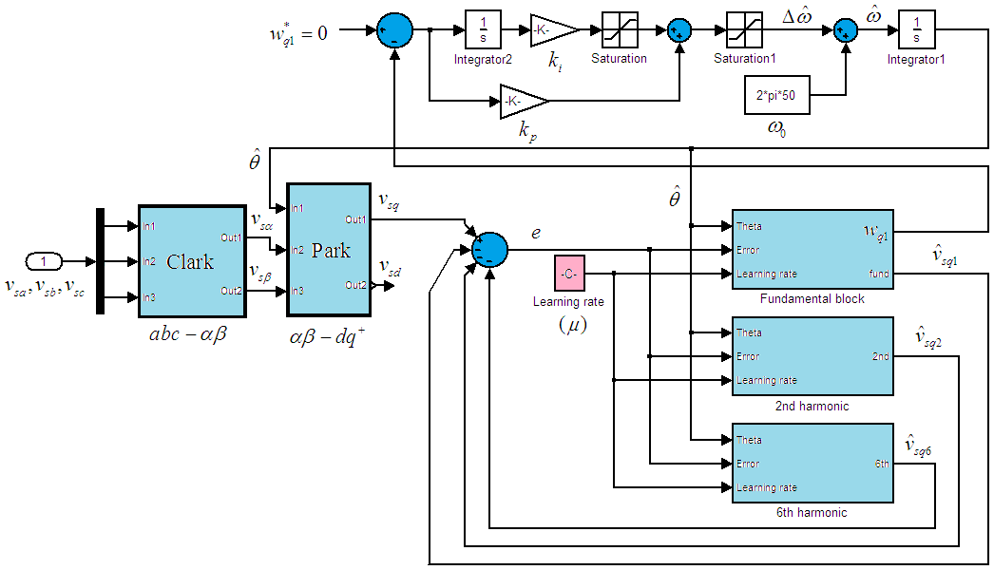
Synchronous Models
All components execute in a sequence of (logical) rounds in lock-step
Example: Component blocks in digital hardware circuit
Clock drives all components in a synchronized manner
Key idea in synchronous languages:
Design system using such a synchronous round-based computation
Benefit: Design is simpler (why?)
Challenge: Ensure synchronous execution even if implementation platform is not single-chip hardware
CIS 540 Spring 2015; Lecture Jan 21

Slide 4
First Example: Delay
bool in
bool x := 0
bool out
out:=x ; x:= in
Input variable: in of type Boolean
Output variable: out of type Boolean
State variable: x of type Boolean
Initialization of state variables: assignment x:=0
In each round, in response to an input, produce output and update state by executing the update code: out:=x; x:=in
CIS 540 Spring 2015; Lecture Jan 21

Slide 5
Delay: Round-based Execution
bool in
bool x := 0
bool out
out:=x ; x:= in
Initialize state to 0
Repeatedly execute rounds. In each round:
Choose a value for the input variable in
Execute the update code to produce output out and change state
Sample execution:
0
1 / 0
1 / 1
0 / 1
0 / 0
1 / 0
1
1
0
0
1
CIS 540 Spring 2015; Lecture Jan 21

Slide 6
Synchrony Hypothesis
Assumption: Time needed to execute the update code is negligible compared to delay between successive input arrivals
Logical abstraction:
Execution of update code takes zero time
Production of outputs and reception of inputs occurs at same time
When multiple components are composed, all execute synchronously and simultaneously
Implementation must ensure that this design-time assumption is valid
CIS 540 Spring 2015; Lecture Jan 21

Slide 7
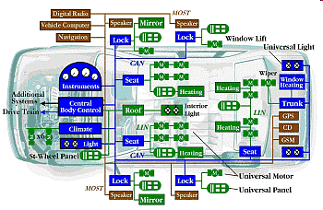
Components in an Automobile
Components need to communicate and coordinate over a shared bus
Design abstraction: Synchronous time-triggered communication
Time is divided into slots
In each slot, exactly one component sends a message over the bus
CAN protocol implements time-triggered communication
CIS 540 Spring 2015; Lecture Jan 21

Slide 8
Synchronous Reactive Component
Delay
bool x := 0
bool out
bool in
out:=x ; x:= in
Inputs
Outputs
State variables:
Declaration + Initialization
Update code:
To be executed in each round
CIS 540 Spring 2015; Lecture Jan 21

Slide 9
Model Definition
Syntax: How to describe a component?
Variable declarations, types, code describing update …
Semantics: What does the description mean?
Defined using mathematical concepts such as sets, functions …
Formal: Semantics is defined precisely
Necessary for tools for analysis, compilation, verification …
Defining formal semantics for a “real” language is challenging
But concepts can be illustrated on a “toy” modeling language
Our modeling language: Synchronous Reactive Components
Representative of many “academic” proposals
Industrial-strength synchronous languages
Esterel, Lustre, VHDL, Verilog, Stateflow…
CIS 540 Spring 2015; Lecture Jan 21

Slide 10
SRC Definition (1): Inputs
Delay
Inputs
bool in
Each component has a set I of input variables
Variables have types. E.g. bool, int, nat, real, {on, off} …
Input: Valuation of all the input variables
The set of inputs is denoted Q_{I}
For Delay
I contains a single variable in of type bool
The set of inputs is {0, 1}
Example: I contains two variables: int x , bool y
Each input is a pair: (integer value for x and 0/1 value for y)
CIS 540 Spring 2015; Lecture Jan 21

Slide 11
SRC Definition (2): Outputs
Delay
Outputs
bool out
Each component has a set O of typed output variables
Output: Valuation of all the output variables
The set of outputs is denoted Q_{O}
For Delay
O contains a single variable out of type bool
The set of outputs is {0, 1}
CIS 540 Spring 2015; Lecture Jan 21

Slide 12
SRC Definition (3): States
Delay
State variables:
Declaration
bool x
Each component has a set S of typed state variables
State: Valuation of all the state variables
The set of states is denoted Q_{S}
For Delay
S contains a single variable x of type bool
The set of states is {0, 1}
State is internal and maintained across rounds
CIS 540 Spring 2015; Lecture Jan 21

Slide 13
SRC Definition (4): Initialization
Delay
State variables:
Declaration + Initialization
bool x := 0
Initialization of state variables specified by Init
Sequence of assignments to state variables
Semantics of initialization:
The set [Init] of initial states, which is a subset of Q_{S}
For Delay
Init is given by the code fragment x:=0
The set [Init] of initial states is {0}
Component can have multiple initial states
Example: bool x := choose {0, 1}
CIS 540 Spring 2015; Lecture Jan 21

Slide 14
SRC Definition (5): Reactions
Delay
Update code:
To be executed in
each round
out:=x ; x:= in
Execution in each round given by code fragment React
Sequence of assignments and conditionals that assign output variables and update state variables
Semantics of update:
The set [React] of reactions, where each reaction is of the form (old) state -- input / output → (new) state
[React] is a subset of Q_{S} x Q_{I} x Q_{O} x Q_{S}
For Delay:
React is given by the code fragment out:=x; x:=in
There are 4 reactions: 0 -0/0-> 0; 0 -1/0-> 1; 1 -0/1-> 0; 1 -1/1-> 1
CIS 540 Spring 2015; Lecture Jan 21

Slide 15
Multiple Reaction component Lossy delay
bool in
bool x := 0
bool out
out:=x ; x:= choose { in, x}
During update, either x is updated to input in, or left unchanged
Motivation: models that an input may be “lost”
Nondeterministic reactions
Given (old) state and input, output/new state need not be unique
The set [React] of reactions now contains
0 -0/0-> 0
0 -1/0-> 1; 0 -1/0-> 0
1 -0/1-> 0; 1 -0/1-> 1
1 -1/1-> 1
CIS 540 Spring 2015; Lecture Jan 21

Slide 16
Not Input enabled component Blocking delay
bool in
bool x := 0
bool out
if x != in then { out:=x; x:=in}
A component may not accept all inputs in all states
Motivation: “blocking” communication
Possible set of reactions in certain state/input combinations may be empty
The set [React] of reactions now contains
0 -1/0-> 1
1 -0/1-> 0
Deadlock!
CIS 540 Spring 2015; Lecture Jan 21

Slide 17
Syntax Errors
bool in
bool x := 0
bool out
x := out; out:= in
If update code cannot be executed, then no reaction possible
In above: set [React] of reactions is the empty set
Update code expected to satisfy a number of requirements
Types of variables and expressions should match
Output variables must first be written before being read
Output variable must be explicitly assigned a value
CIS 540 Spring 2015; Lecture Jan 21

Slide 18
Semantic Equivalence
DiffSquare1
DiffSquare
local int x, y;
x := in1 + in2;
y := in1 –in2;
out := x * y
int in1
int in1
int out
int out
out := in1² – in2²
int in2
int in2
Both have identical sets of reactions
Syntactically different but semantically equivalent
Compiler can optimize code as long as semantics is preserved!
CIS 540 Spring 2015; Lecture Jan 21

Slide 19
Synchronous Reactive Component Definition
Set I of typed input variables: gives set Q_{I} of inputs
Set O of typed output variables: gives set Q_{O} of outputs
Set S of typed state variables: gives set Q_{S} of states
Initialization code Init: defines set [Init] of initial states
Reaction description React: defines set [React] of reactions of the form s –i/o-> t, where s, t are states, I is an input, and o is an output
Synchronous languages in practice:
Richer syntactic features to describe React
Key to understanding: what happens in a single reaction?
Formal semantics: Necessary for development of tools!
CIS 540 Spring 2015; Lecture Jan 21

Slide 20
Definition of Executions
Given component C = (I, O, S, Init, React), what are its executions?
Initialize state to some state s₀ in [Init]
Repeatedly execute rounds. In each round n=1,2,3,…
Choose an input value i_{n} in Q_{I}
Execute React to produce output o_{n} and change state to s_{n}
that is, s_{n-1} – i_{n} / o_{n} → s_{n} must be in [React]
Sample execution:
s₀
i₁ / o₁
i₂ / o₂
s₂
i₃ / o₃
s₃
s₁
CIS 540 Spring 2015; Lecture Jan 21

Slide 21
What does this component do ?
bool x := 0; y:= 0
bool in
if y then out := x
else out := 0;
x := in;
y := ~ y
bool out
CIS 540 Spring 2015; Lecture Jan 21

Slide 22
Extended State Machines
Input: bool press
( press=0 & x<10 )
→ x:=x+1
(press=0) ?
(press=1) ?
int x:=0
off
on
( press=1 | x>=10 )
→ x:=0
mode is a state variable ranging over {on, off}
Reaction corresponds to executing a mode-switch
Example mode-switch: from on to off with
Guard (press=1 | x>=10) and Update code x:=0
CIS 540 Spring 2015; Lecture Jan 21

Slide 23
Executing ESMs: Switch
Input: bool press
( press=0 & x<10 )
→ x:=x+1
(press=0) ?
(press=1) ?
int x:=0
off
on
( press=1 | x>=10 )
→ x:=0
State of the component Switch assigns values to mode and x
Initial state: (off, 0)
Sample Execution:
(off,0) -0-> (off,0) -1-> (on,0) -0-> (on,1) -0-> (on,2) … -0->(on,10) -0-> (off,0)
CIS 540 Spring 2015; Lecture Jan 21

Slide 24
Modified Switch: What executions are possible?
Input: bool press
( press=0 & x<=10 )
→ x:=x+1
(press=0)?
(press=1) ?
int x:=0
off
on
( press=1 | x>=10 )
→ x:=0
CIS 540 Spring 2015; Lecture Jan 21

